Slide 1
Microsoft Power BI

Slide 2
Integrating Azure AD B2C with App-Owns-Data Embedding
Ted Pattison
Principal Program Manager
Power BI Customer Advisory Team (PBICAT)

Slide 3
Agenda
Understanding Azure AD B2C Architecture
Building and Testing User Flows
Acquiring B2C tokens using msal-browser.js
Managing B2C User Accounts using Microsoft Graph API
Developing Custom Policies using Visual Studio Code
Using Azure functions to implement and deploy API Connectors

Slide 4
What is Azure AD B2C?
Identity Provider for the Internet
Reach any potential customer on the Internet who has a valid email address
Consumer users can signup or sign in using social accounts or enterprise accounts
Consumer users can signup by creating local account
Azure AD B2C handles self-service features for email verification and password reset
Azure AD B2C is a Customer Identity and Access Management (CIAM) solution
Azure AD B2C provides consumer-centric authorization and identity as a service
Azure AD B2C competes against other CIAM solution including OneLogin, Auth0, Ping and Okta

Slide 5
Comparing Azure AD B2B versus Azure AD B2C
Azure AD B2C is a separate service from Azure AD
Designed to support customer-facing applications
Supports federating user accounts from external identity providers
Supports creating local user account for any human with email address
Provides self-service features for signup and sign in
Provides self-service features for profile editing and password reset
Allows for white labeling user signup/sign in experience
B2C consumer accounts cannot access Azure resources
AAD B2C only provides authentication support to establish user identity
AAD B2C does not provide features for permissions management or authorization

Slide 6

Authenticating Users for App-Owns-Data Embedding
Let’s walk through a typical App-Owns-Data embedding solution
Azure AD B2C fits in perfectly in an App-Owns-Data embedding solution
App-Owns-Data solution provides authorization layer (but it needs help with authentication)
Azure AD B2C provides authentication and identity management (but no help with authorization)
AppOwnsDataReactClient
Azure AD B2C
AppOwnsDataWebApi
Azure AD
Service Principal
Power BI REST API
?
PING
AUTH0
?
OKTA
AppOwnsDataDB
Tenants
Users
Permissions
App-Owns-Data Embedding
Azure AD B2C

Slide 7
Understanding Azure AD B2C Architecture
Azure AD B2C plays role of identity provider
B2C tenant provides access tokens to client applications (i.e. relying parties)
B2C tenant contains its own Authority which exposes public endpoints for user authentication
Each public endpoint has behavior defined by policy loaded from policy store
Policies define behaviors to federate with other identity providers
Policies define behaviors to create and manage local accounts
Social Media Accounts
LinkedIn
Azure B2C Tenant
Identity Provider
authentication services
Facebook
B2C Authority
Live.com
Policy Store - Endpoints
Relying Party
AppOwnsDatReactClient
access
token
Account Federation
Enterprise Accounts
Local Accounts
Azure AD - contoso.com
access
token
Azure AD - wingtip.com
Web API
AppOwnsDataWebApi
Salesforce - acmecorp.com

Slide 8
Creating an Azure AD B2C New Tenant
Requirements for creating a new Azure AD B2C tenant
Azure AD organizational account
Azure subscription
Azure AD Tenant
PowerBiDevCamp.net
Azure AD B2C Tenant
PowerBiDevCampAuth.onMicrosoft.com
AAD Organization Account
tedp@poweridevcamp.net
B2C Authority
powerbidevcampauth.b2clogin.com
Policy Store
Azure Subscription
Local and Federated Users

Slide 9
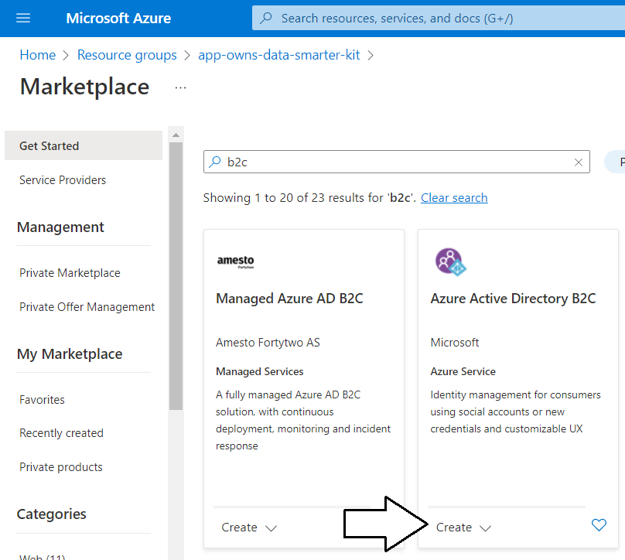
Creating an Azure AD B2C Tenant in the Azure Portal

Slide 10
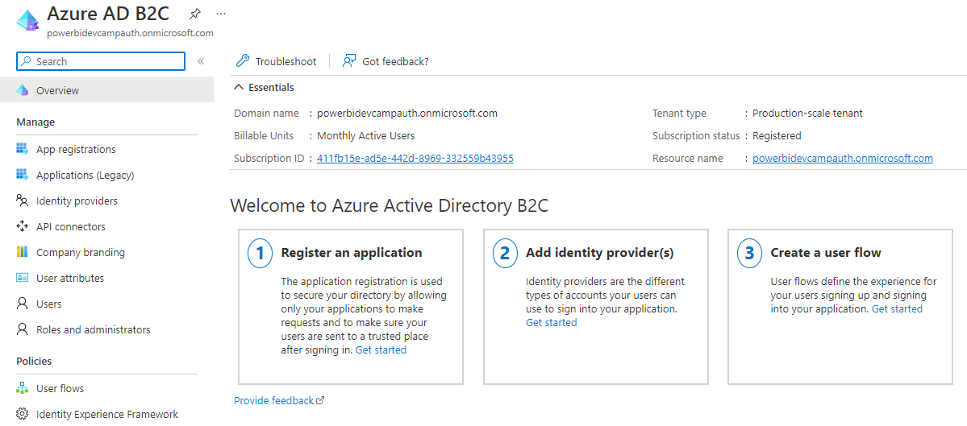
Demo 1 – Getting Around in Azure AD B2C Tenant Portal

Slide 11
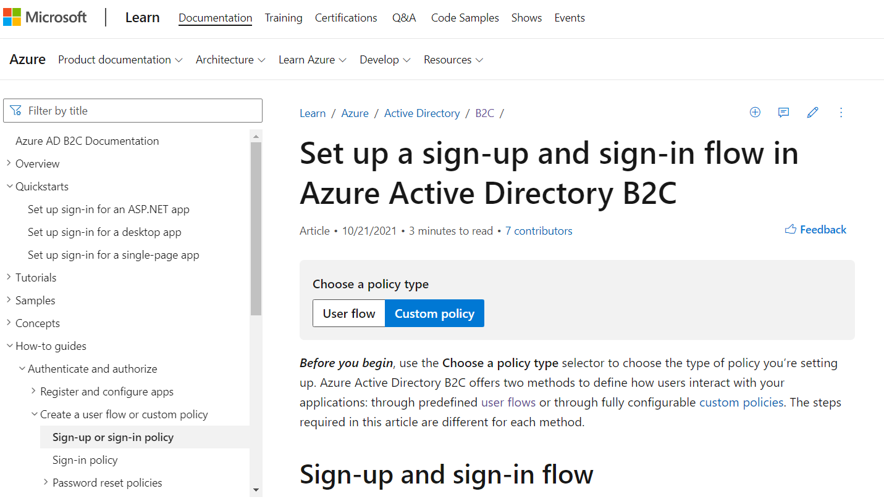
If Success Is Important, Embrace the Azure AD B2C Docs
https://learn.microsoft.com/en-us/azure/active-directory-b2c

Slide 12
Agenda
Understanding Azure AD B2C Architecture
Building and Testing User Flows
Acquiring B2C tokens using msal-browser.js
Managing B2C User Accounts using Microsoft Graph API
Developing Custom Policies using Visual Studio Code
Using Azure functions to implement and deploy API Connectors

Slide 13
Choosing Between User Flows and Custom Policies
There are two ways to create a B2C policy
User flows – UI-based experience for creation and configuration
Custom policies – Developers work with XML files and Identity Experience Framework (IEF)
Reasons to choose user flows over custom policies
Much easier to use – custom policies have steep learning curve
Does not require deep knowledge about claims-based security and access token generation
No code required – everything configured in Azure AD B2C Tenant portal
Reasons to choose custom policies over user flows
More control of what claims go in token – for example, ensure all users have email claim
Federation with enterprise accounts – user flows only support federating social media accounts
Merging accounts during signup - with the same email address

Slide 14
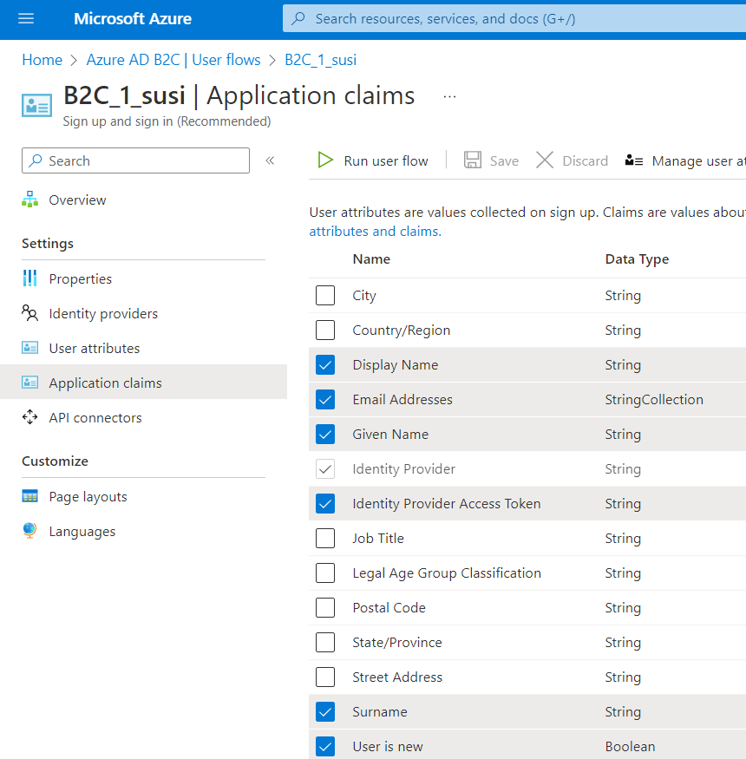
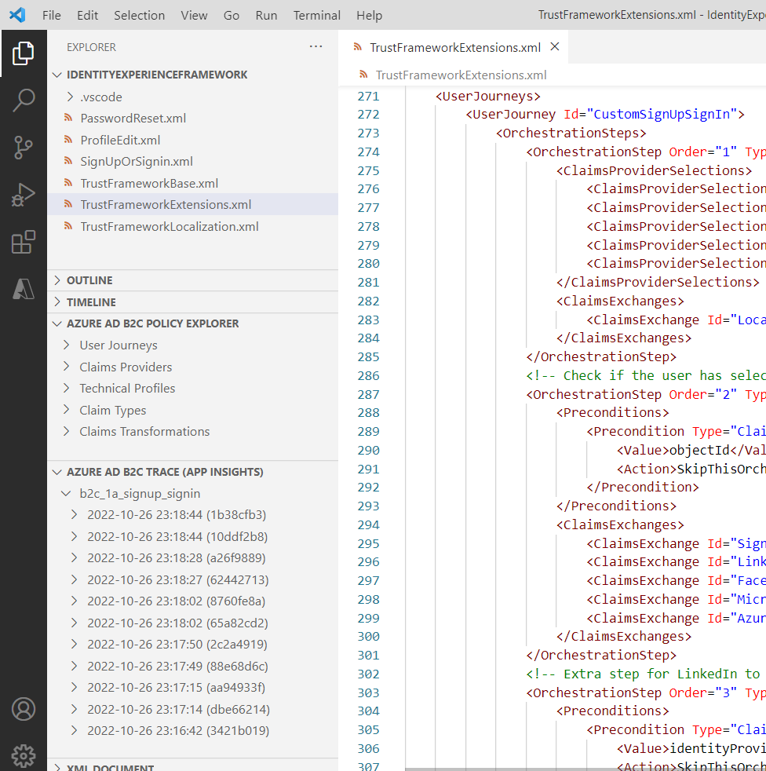
User flow versus Custom Policy Experience for Creators
User Flow Creators Experience
Custom Policy Development Experience

Slide 15
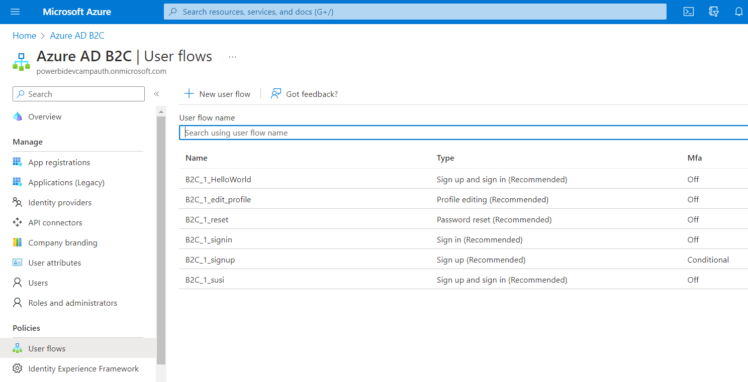
Working with User Flows in the Azure AD B2C Portal

Slide 16
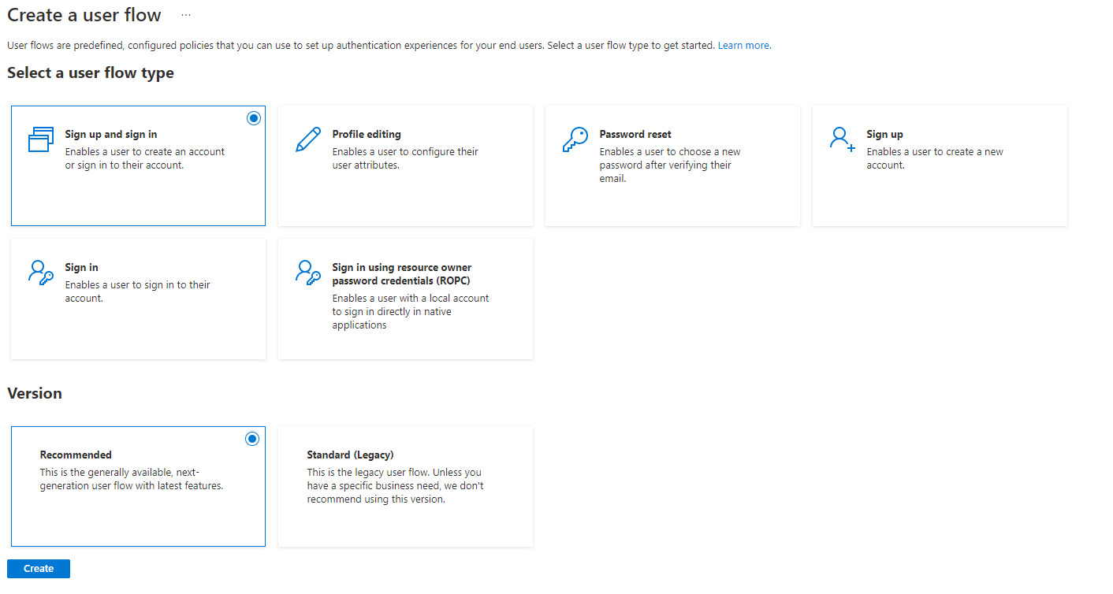
Creating a New User Flow

Slide 17
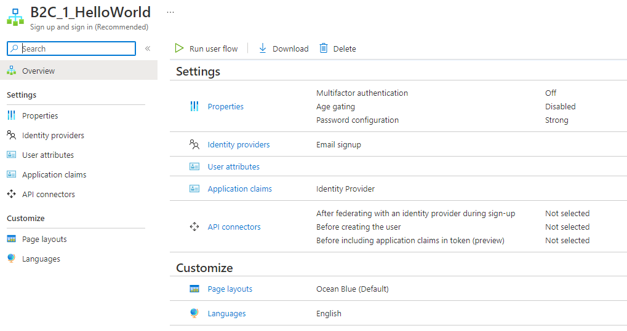
User Flow Configuration Options

Slide 18
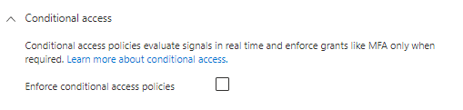
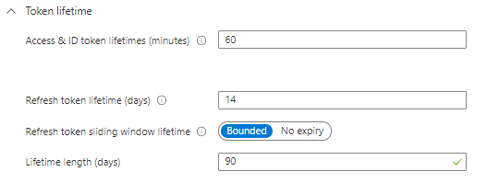
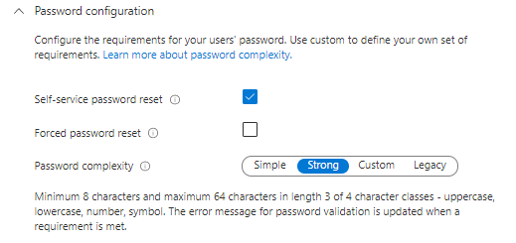
User Flow Configuration Properties
Configure properties to control MFA and conditional access
Configure properties to control token lifetimes and claims compatibility
Configure properties to control session behavior and to enable support for password reset

Slide 19
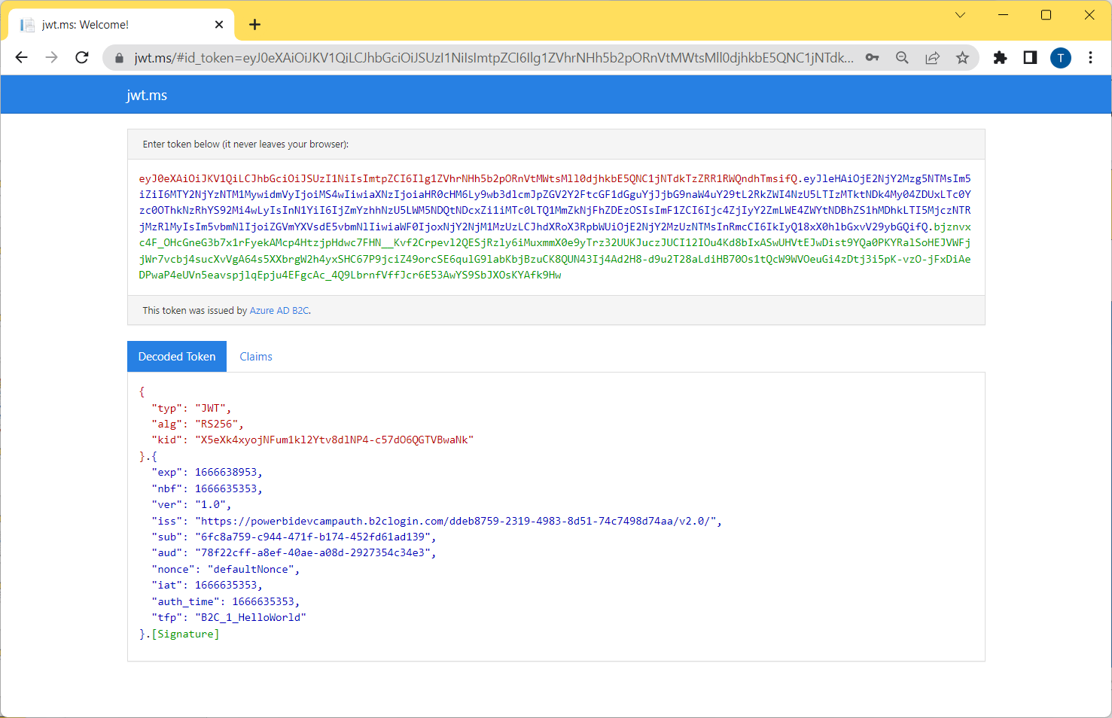
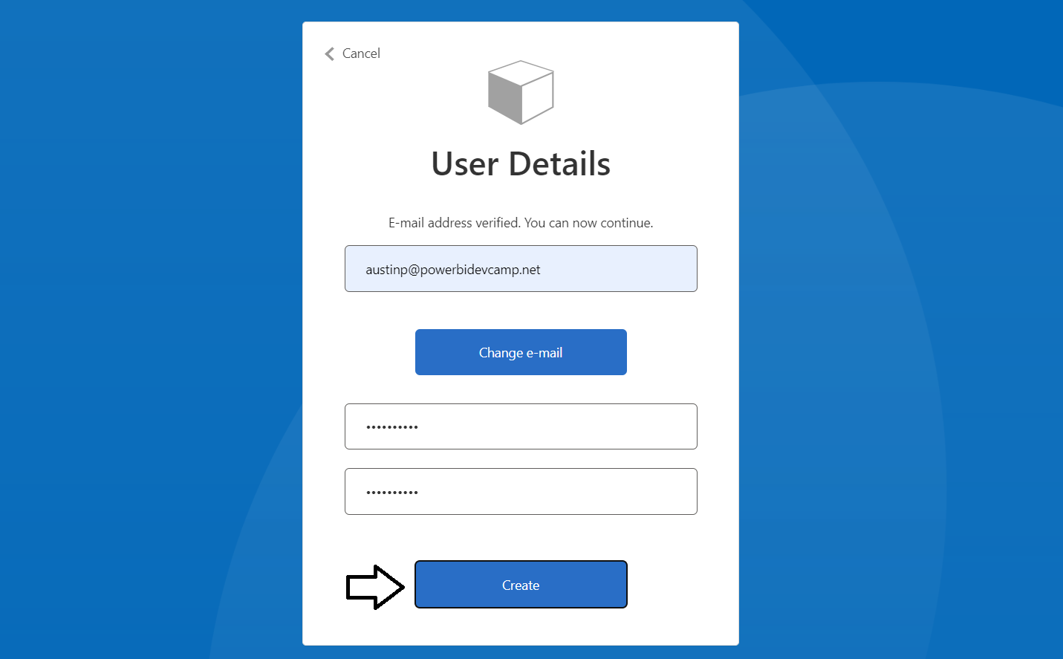
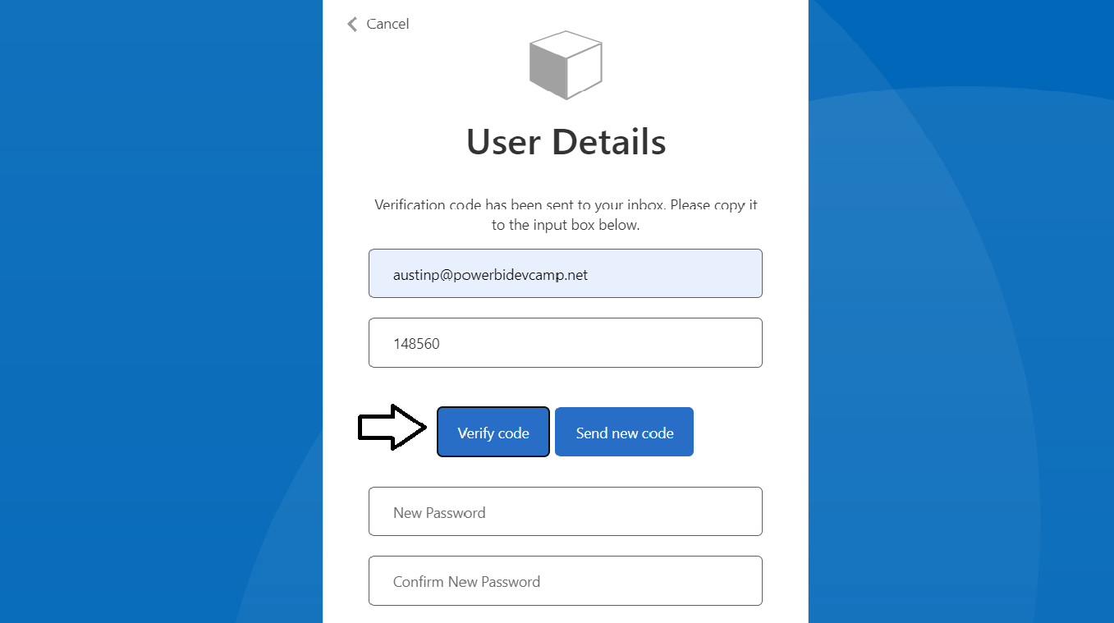
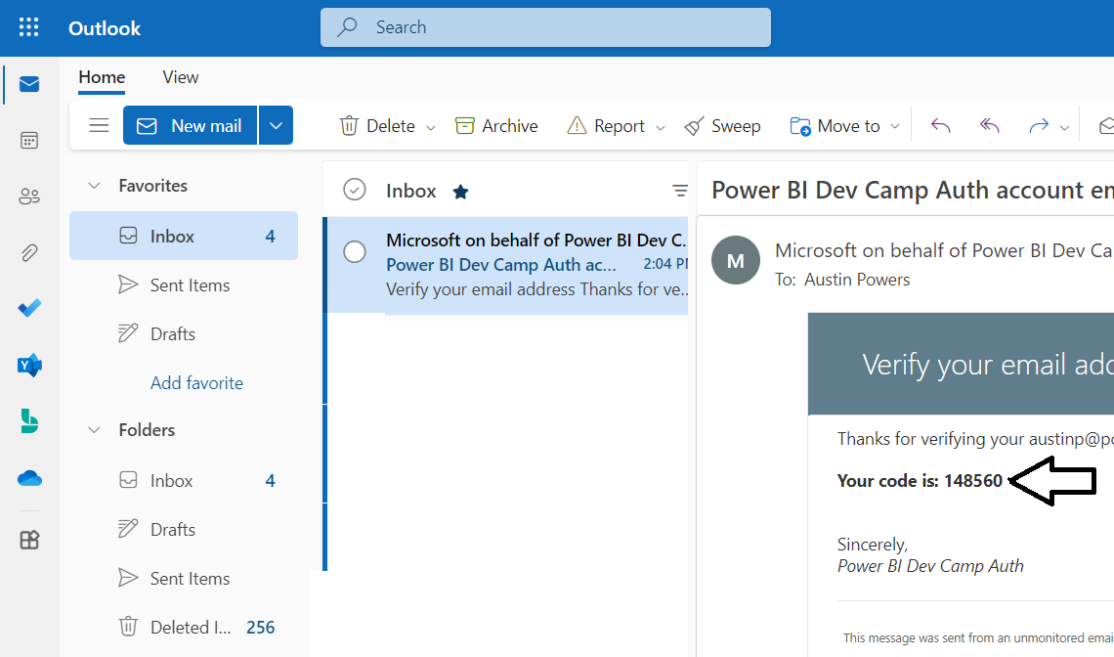
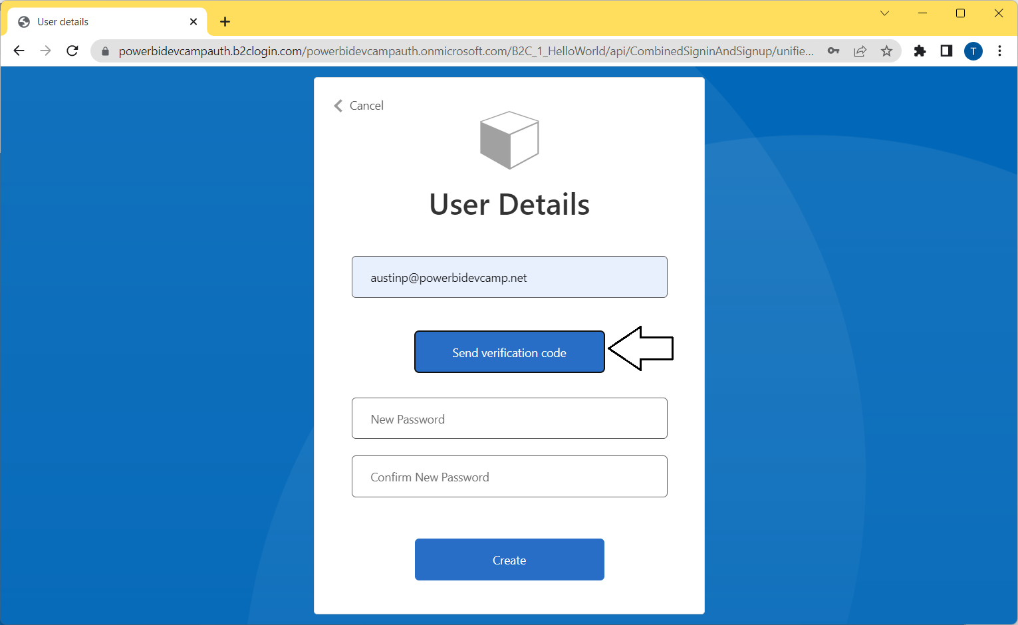
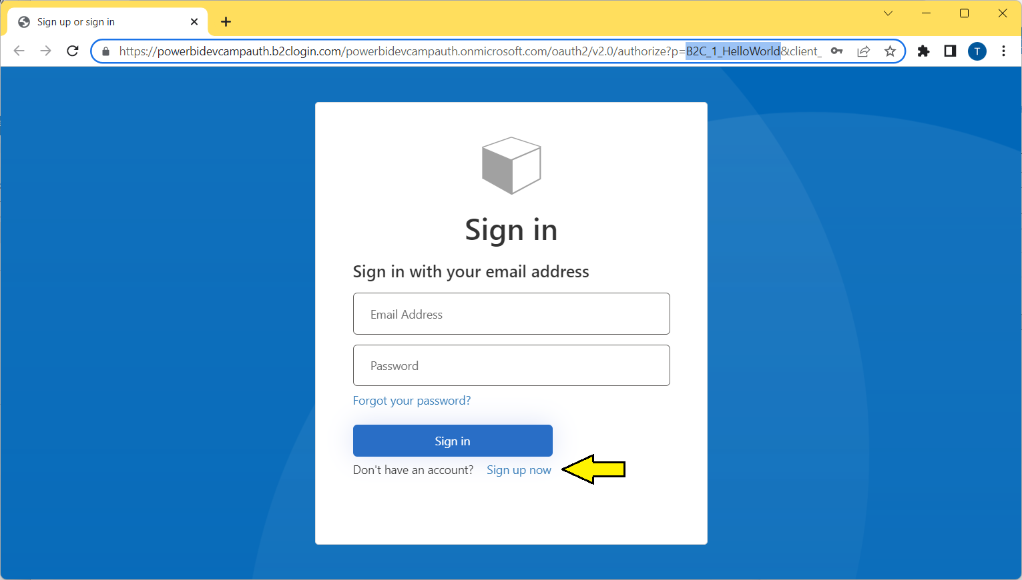
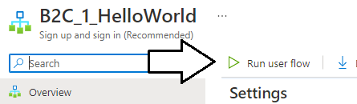
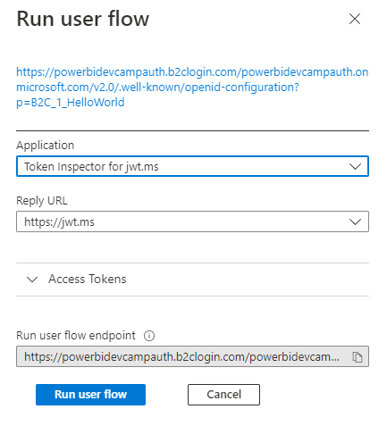
Testing a User Flow for Local Account Signup
NOTE: You must create an Azure AD application for jwt.ms to work properly

Slide 20
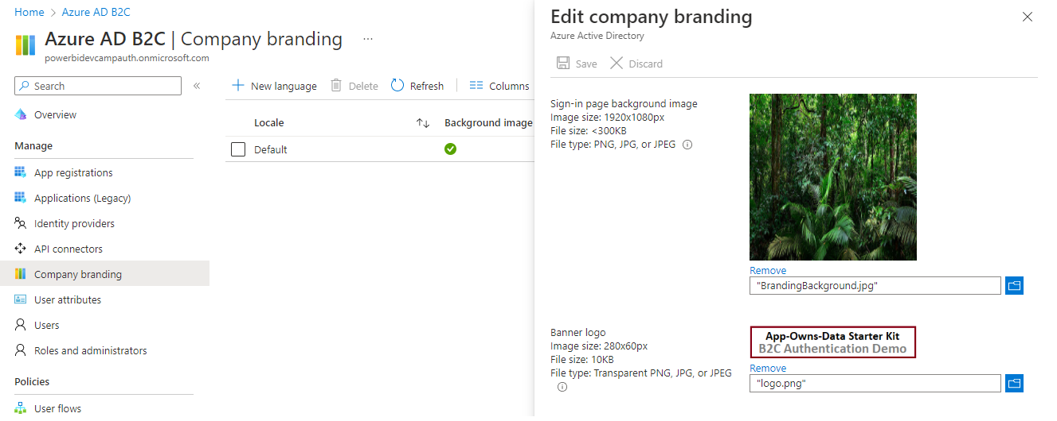
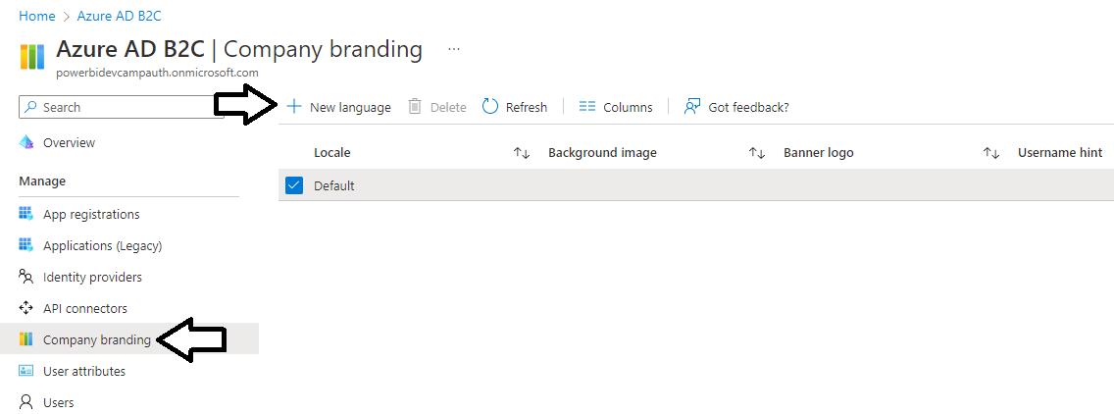
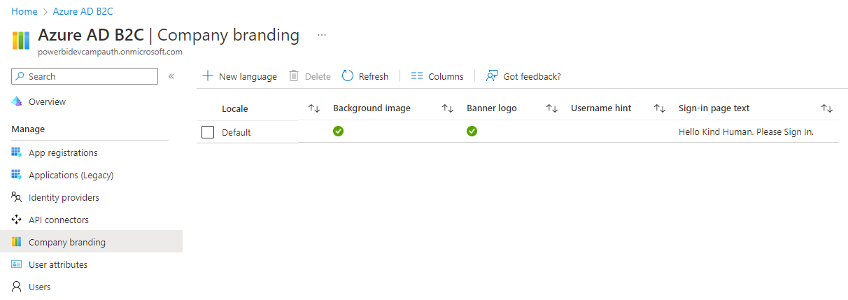
Tenant Settings for Company Branding

Slide 21
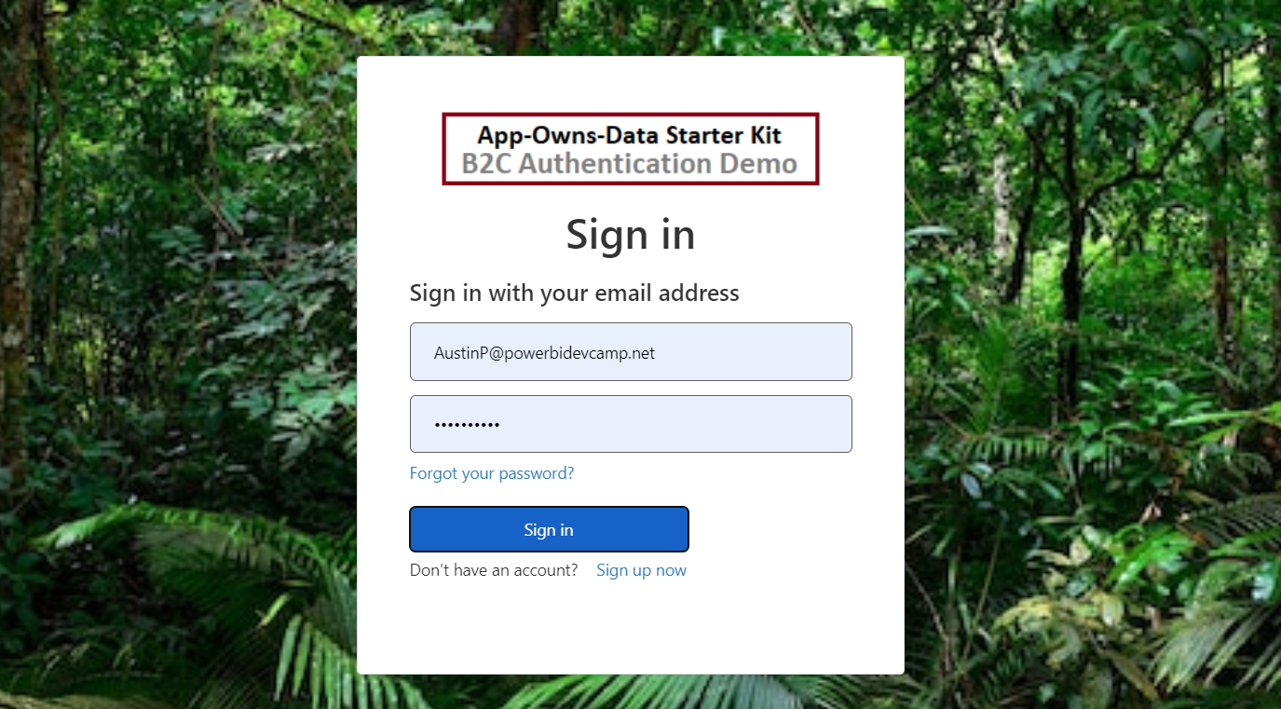
Company Branding Provides Instant Gratification

Slide 22
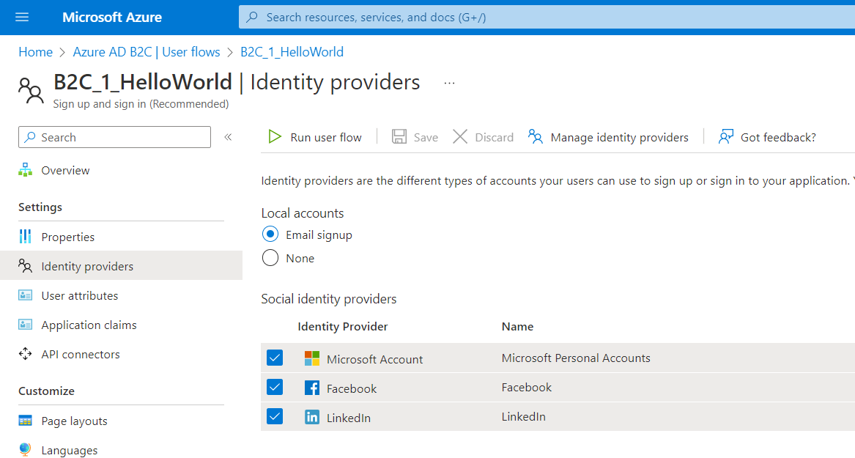
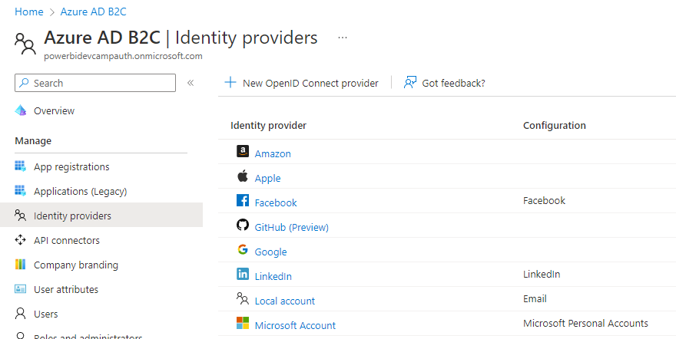
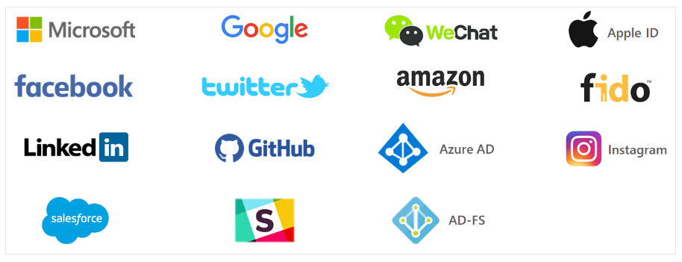
Identity Providers and Social Account Federation
Users can sign in with existing accounts from popular social identity providers
Built-in support to federate accounts from LinkedIn, Facebook, Google, Twitter, etc.
Integration requires creating an “app” in the external identity provider
You configure support for external identity provider in Azure AD B2C portal
You decide which identity providers to support for each individual user flow

Slide 23
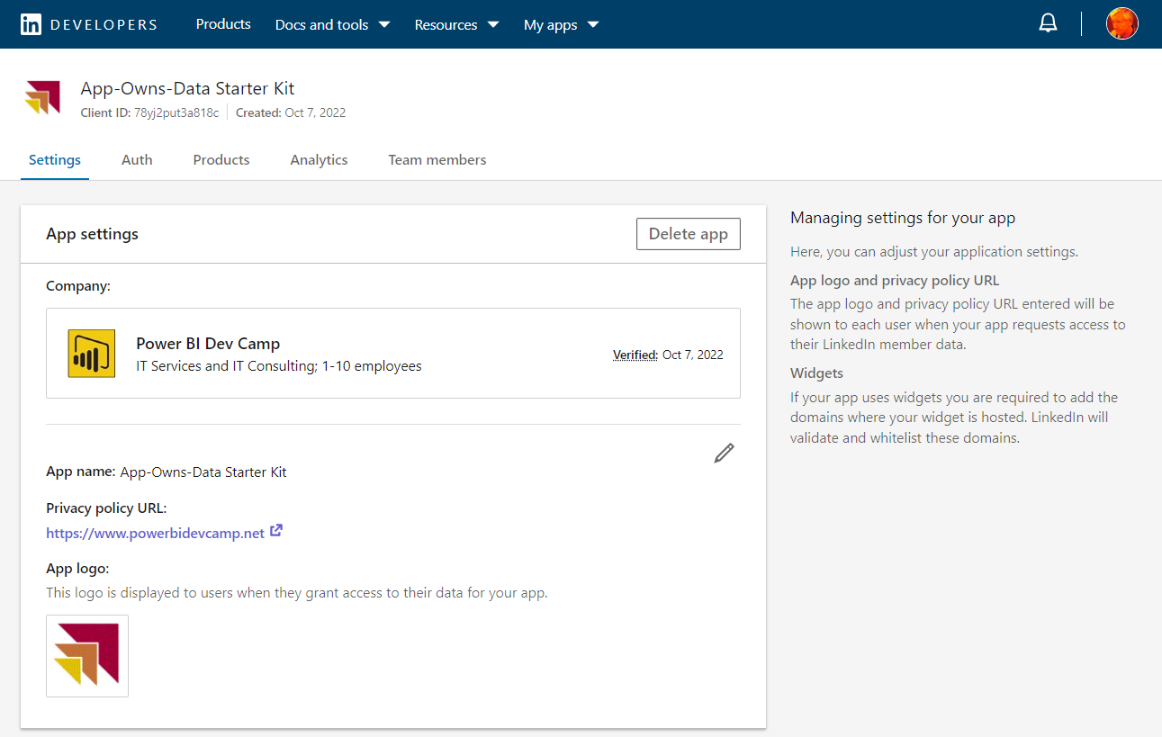
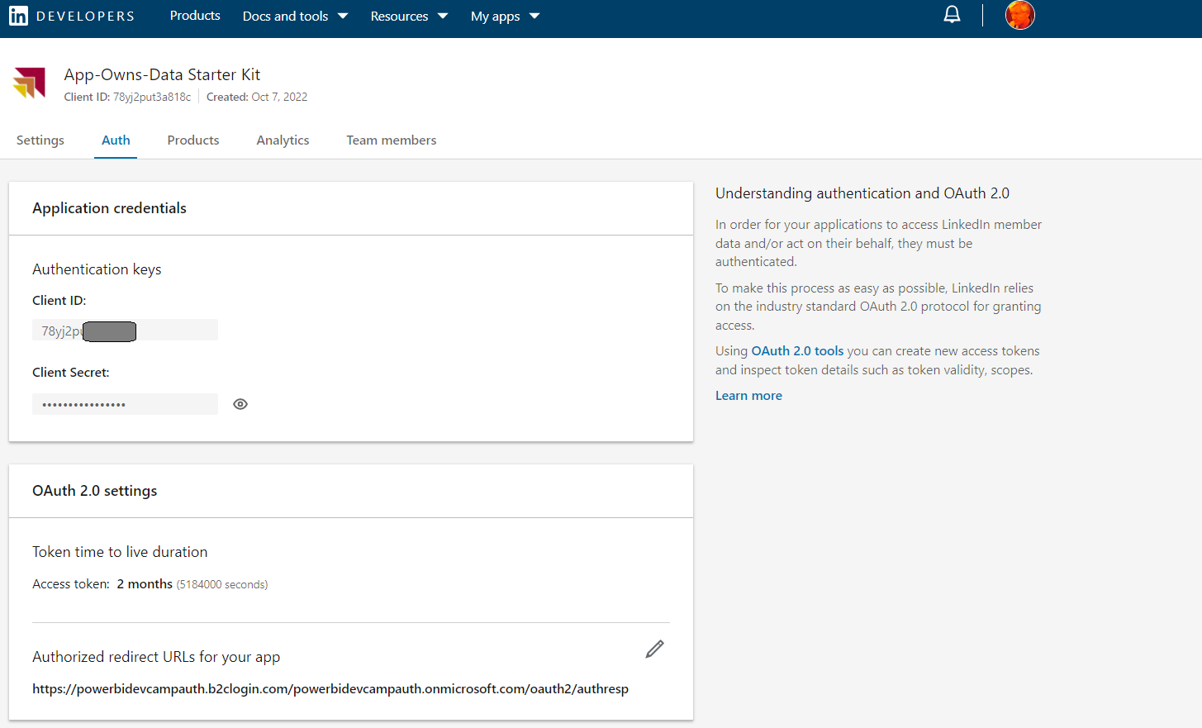
Creating Apps To Integrate with Social Identity Providers

Slide 24
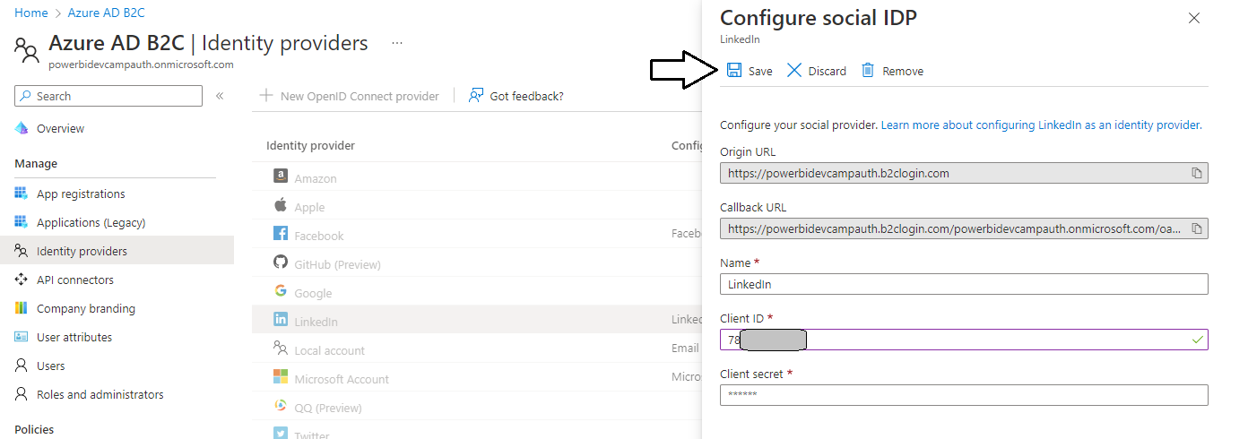
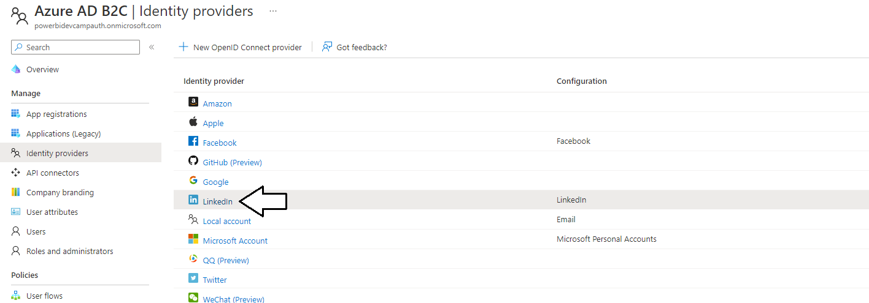
Configuring Identity Provider in AAD B2C Portal

Slide 25
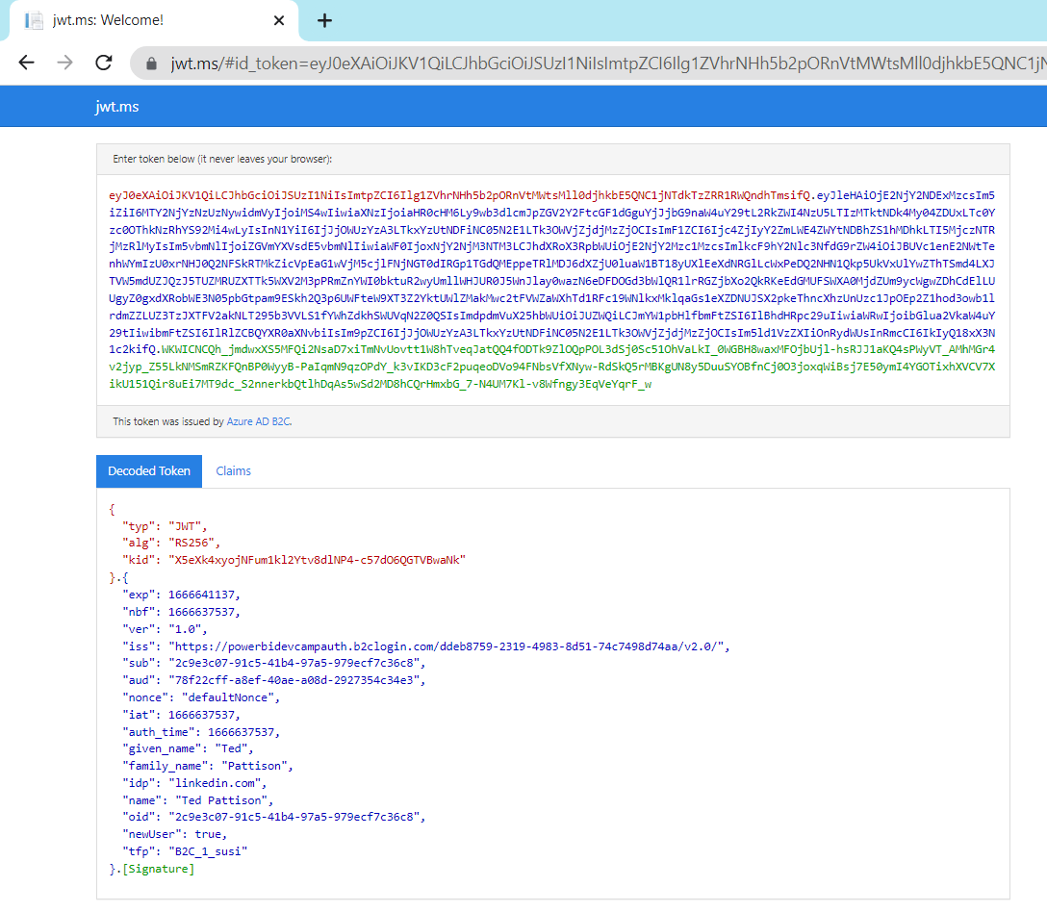
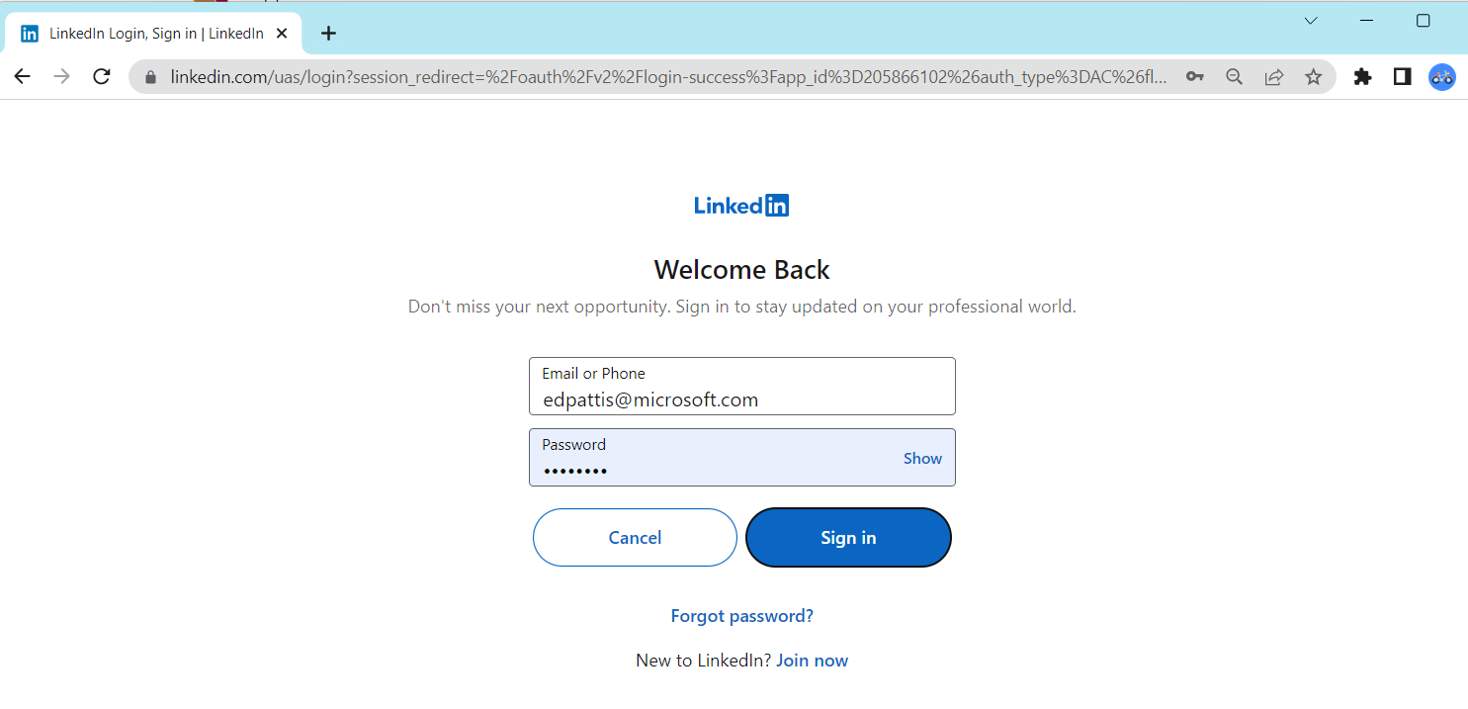
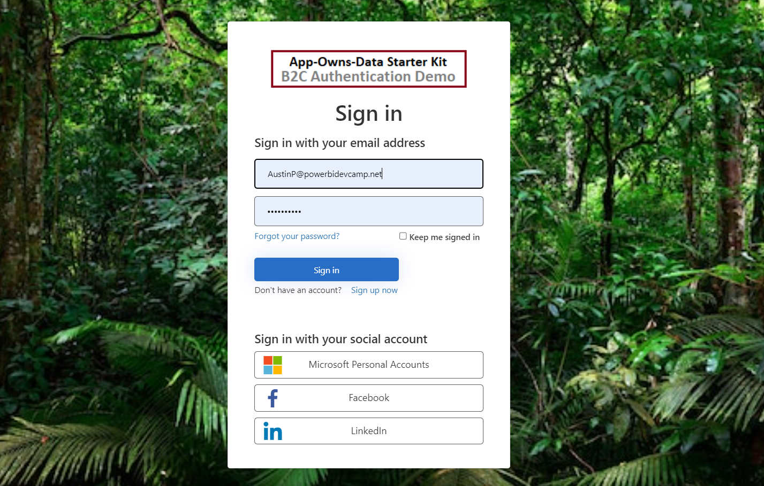
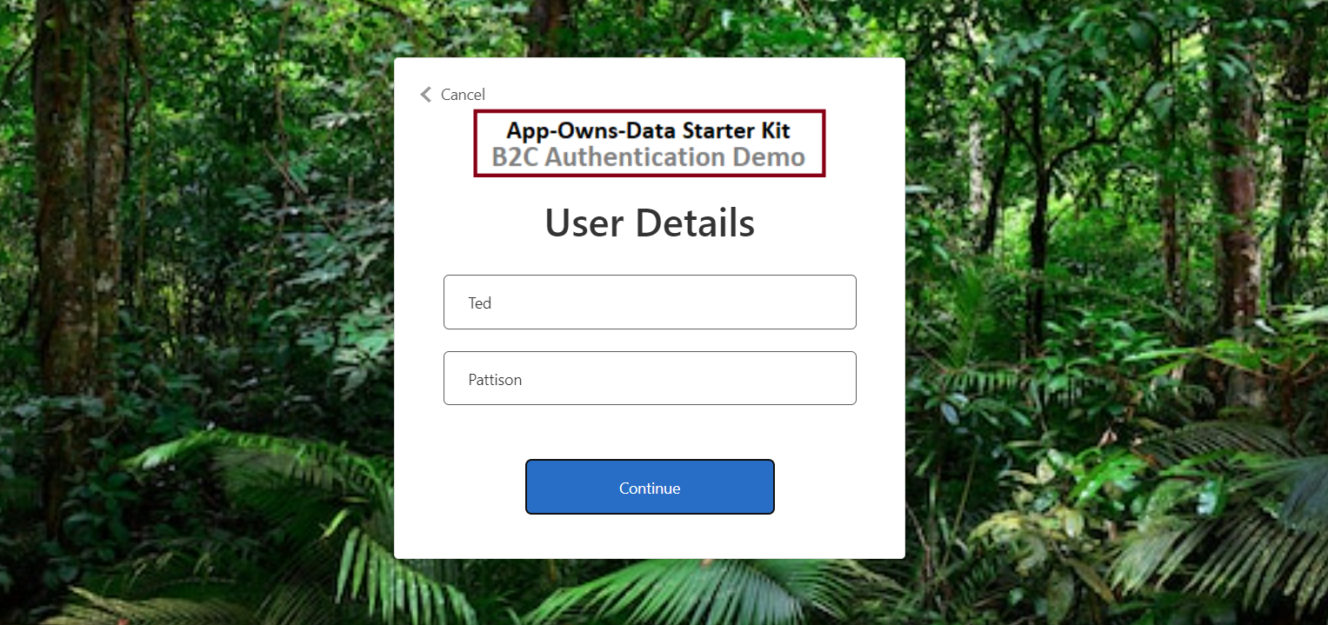
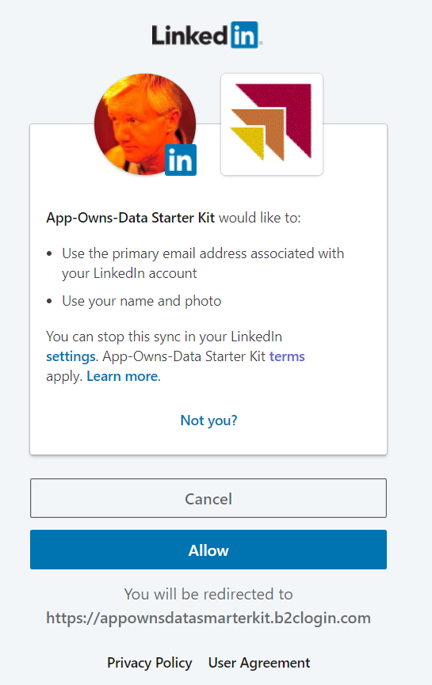
Signup and Sign In with Federated User Accounts

Slide 26
Agenda
Understanding Azure AD B2C Architecture
Building and Testing User Flows
Acquiring B2C tokens using msal-browser.js
Managing B2C User Accounts using Microsoft Graph API
Developing Custom Policies using Visual Studio Code
Using Azure functions to implement and deploy API Connectors

Slide 27
Acquiring Tokens from AD B2C Authority
Each Azure AD B2C authentication endpoint defined by a policy
Replying party redirects the user to policy endpoint to begin authentication flow
Replying party must include scope(s) in request to policy endpoint to acquire access token
B2C authority can optionally provide interactive experience as it executes policy
B2C authority returns access token if policy executes successfully
Relying party transmits access token in calls to Web API where Web API validates access token
Web API inspects access token claims to determine whether use has required access
Azure B2C Authority
powerbidevcampauth.b2clogin.com
LinkedIn
Policy Endpoint
B2C_1_susi
Local
Consumer
Accounts
Facebook
access
token
Live.com
Replying Party
AppOwnsDataReactClint
Policy Endpoint
B2C_1_edit_profile
Azure AD
access
token
Your Secure Web API

Slide 28
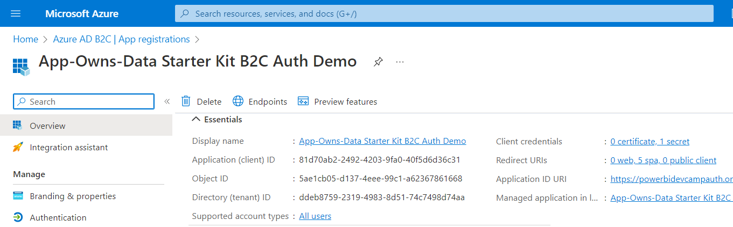
Creating an Application in the Azure AD B2C Tenant

Slide 29
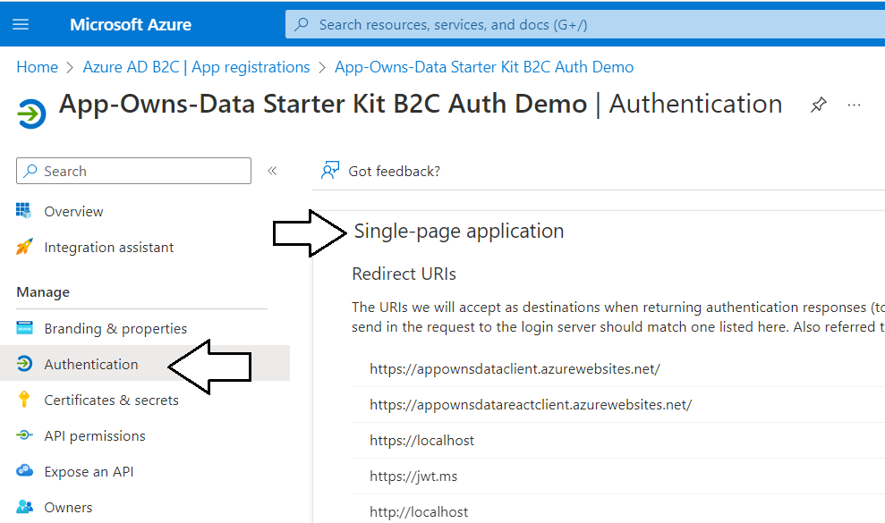
Configuring Application with SPA Authentication

Slide 30
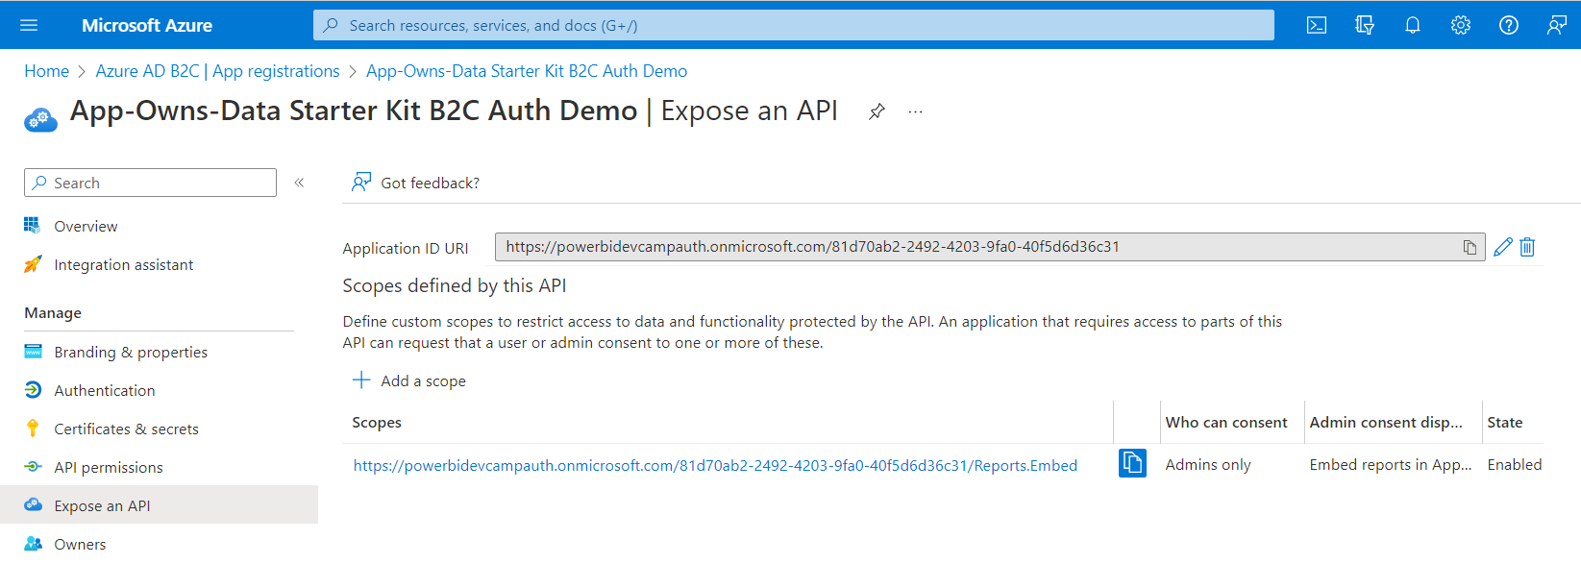
Defining Custom Scope to Expose a Web API

Slide 31
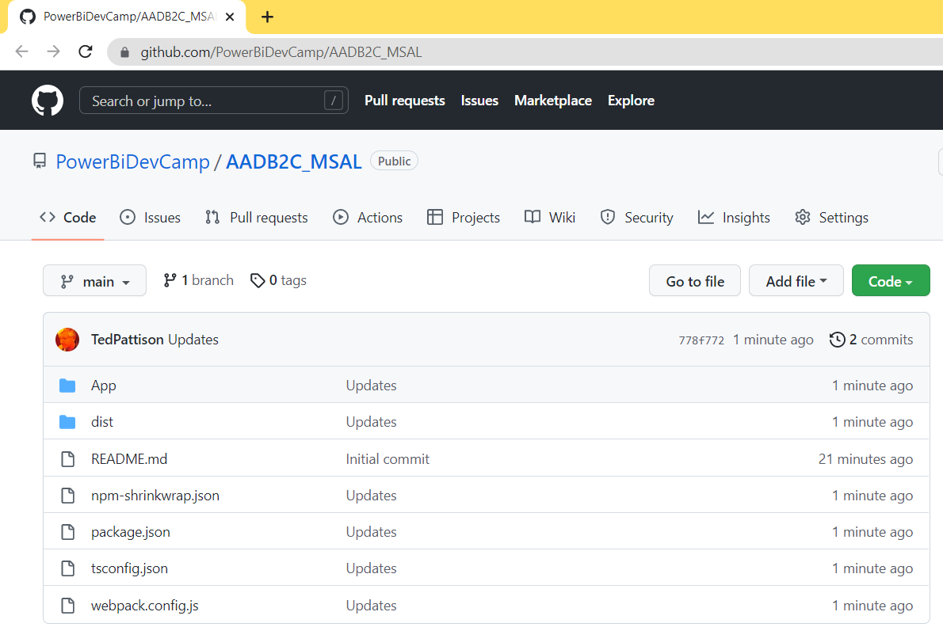
AADB2C_MSAL Sample Application in GitHub
AADB2C_MSAL demonstrates best practice of authenticating with msal-browser.js
Download sample code from https://github.com/PowerBiDevCamp/AADB2C_MSAL

Slide 32
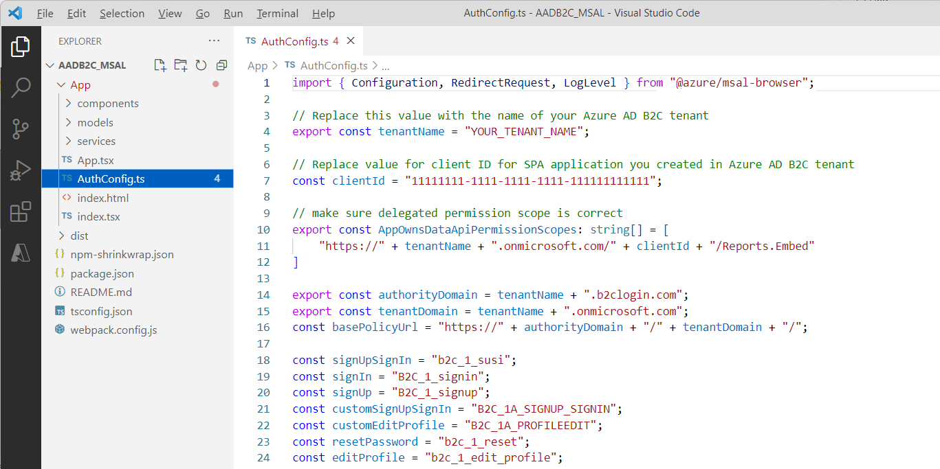
Updating AuthConfig.ts for Your Environment

Slide 33
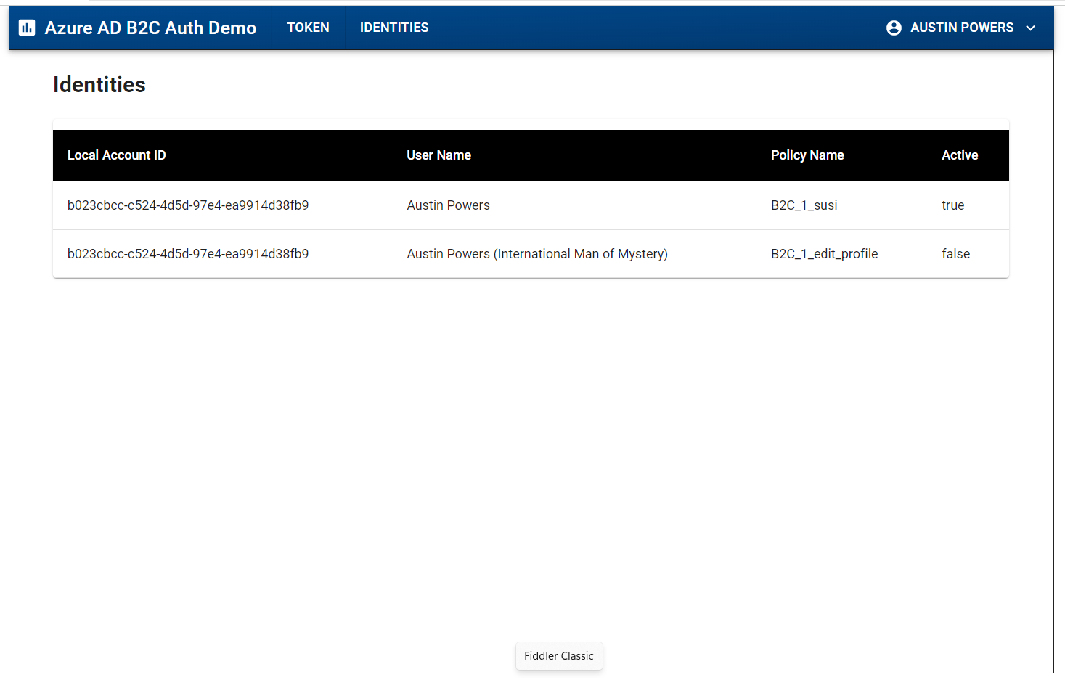
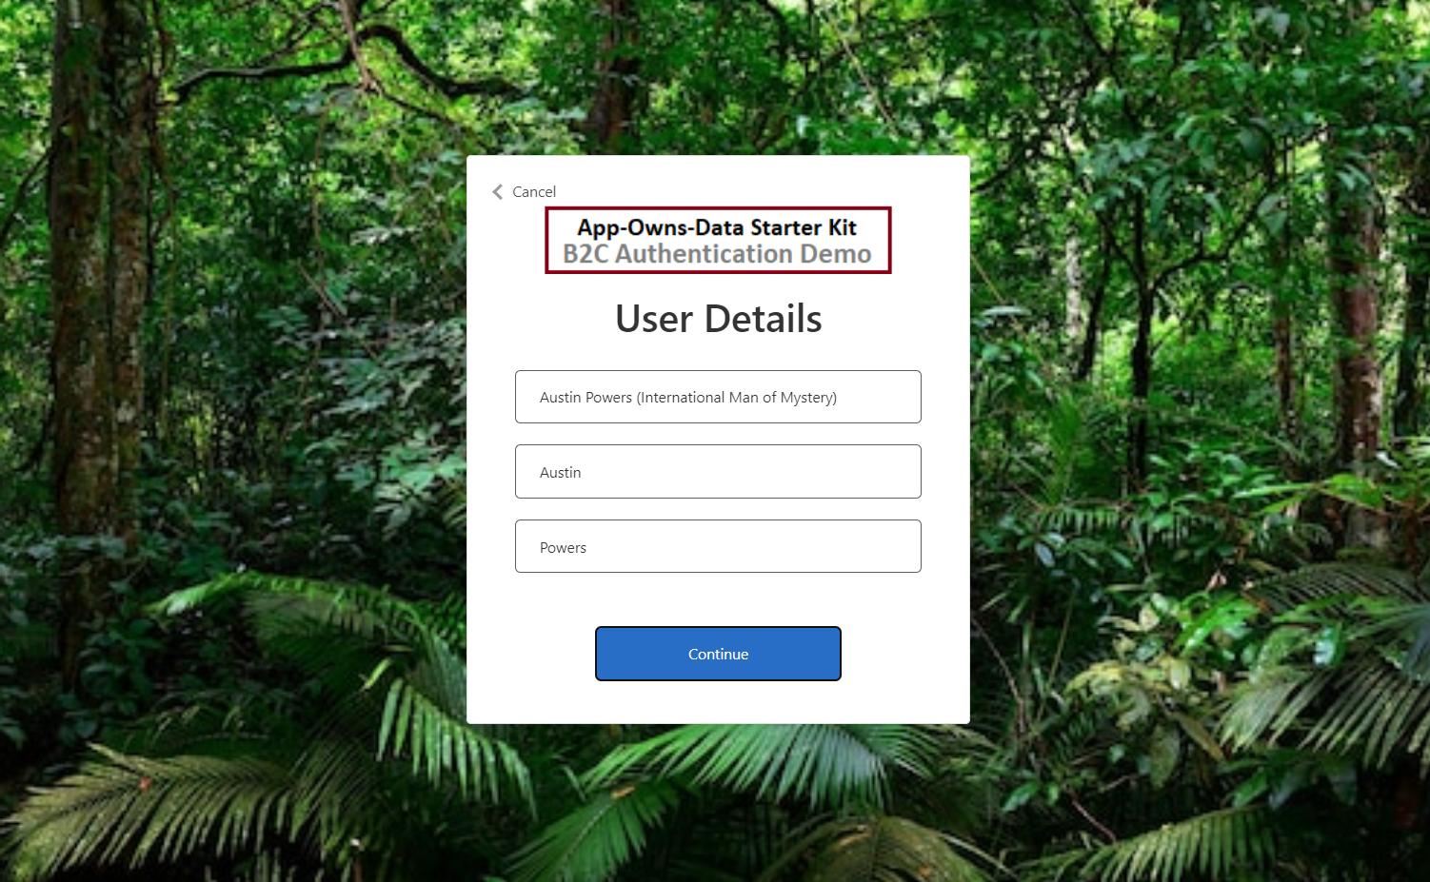
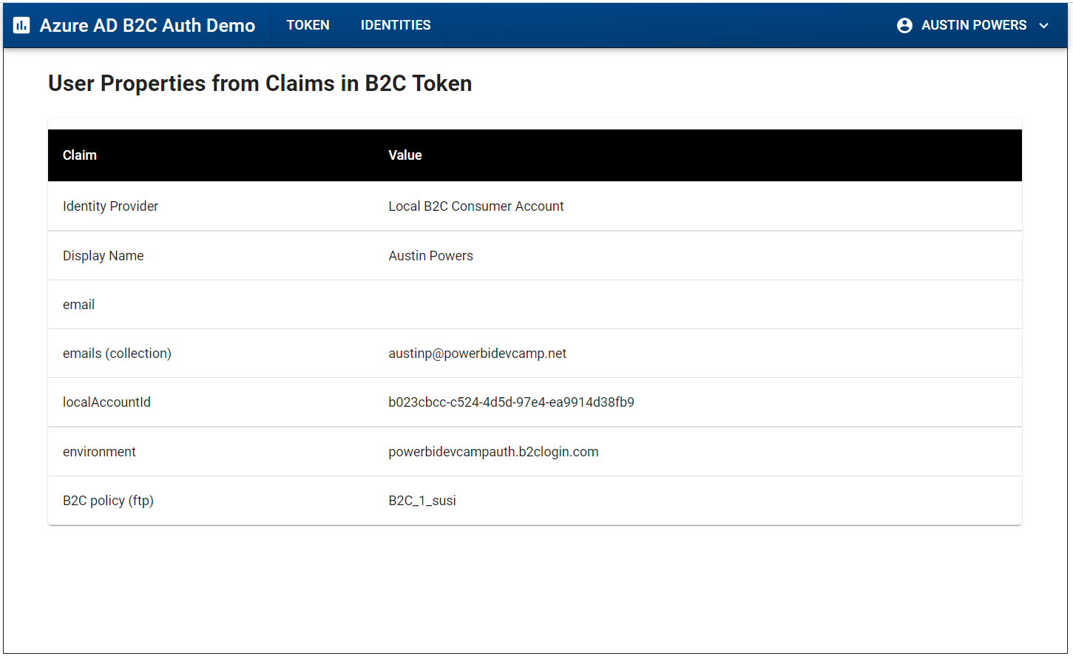
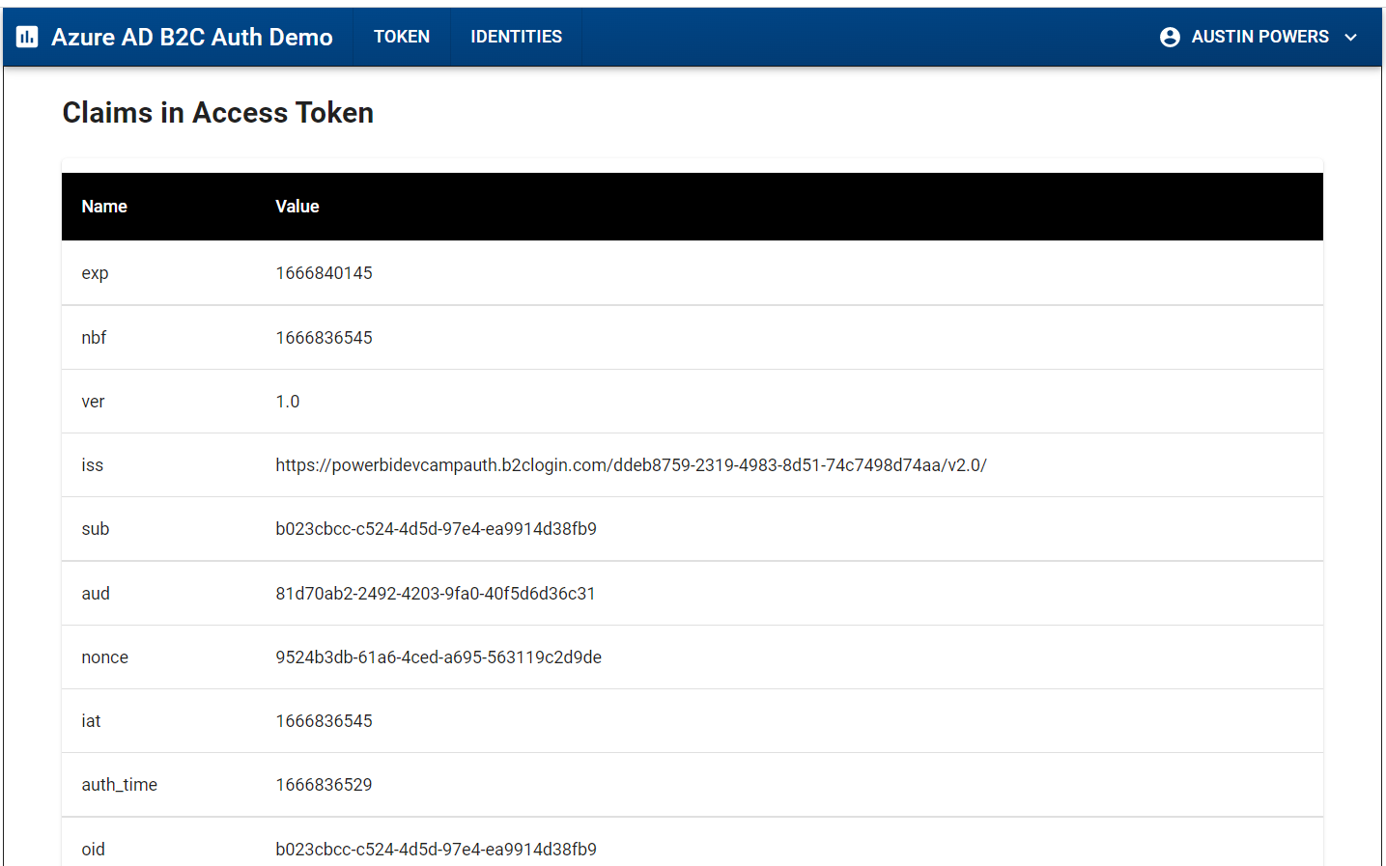
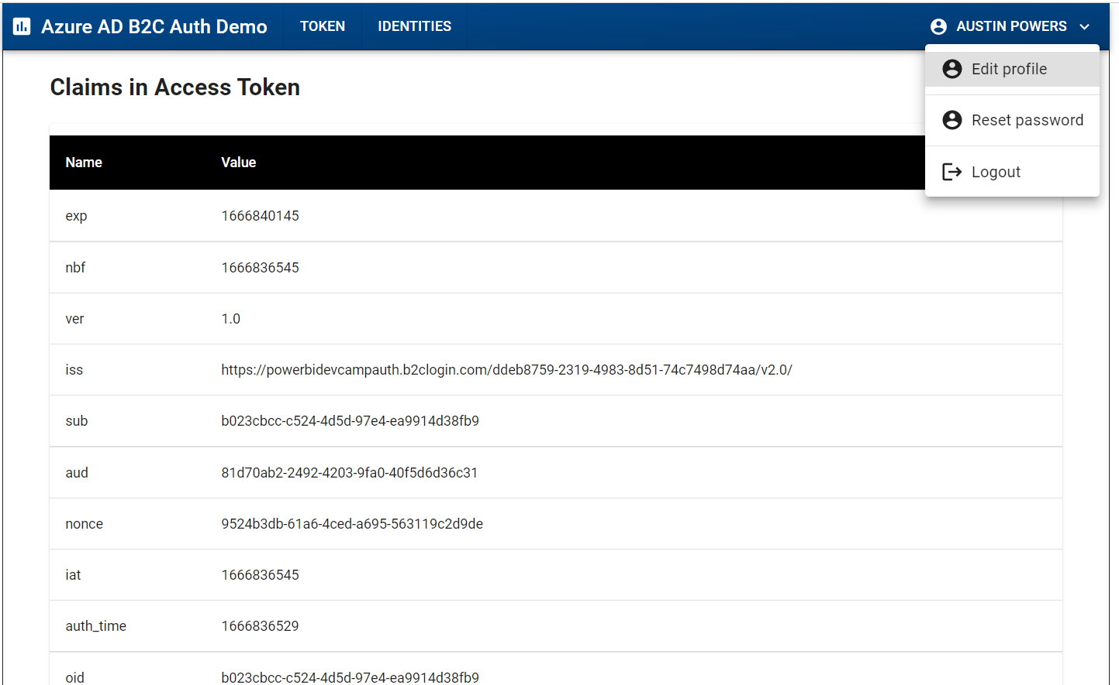
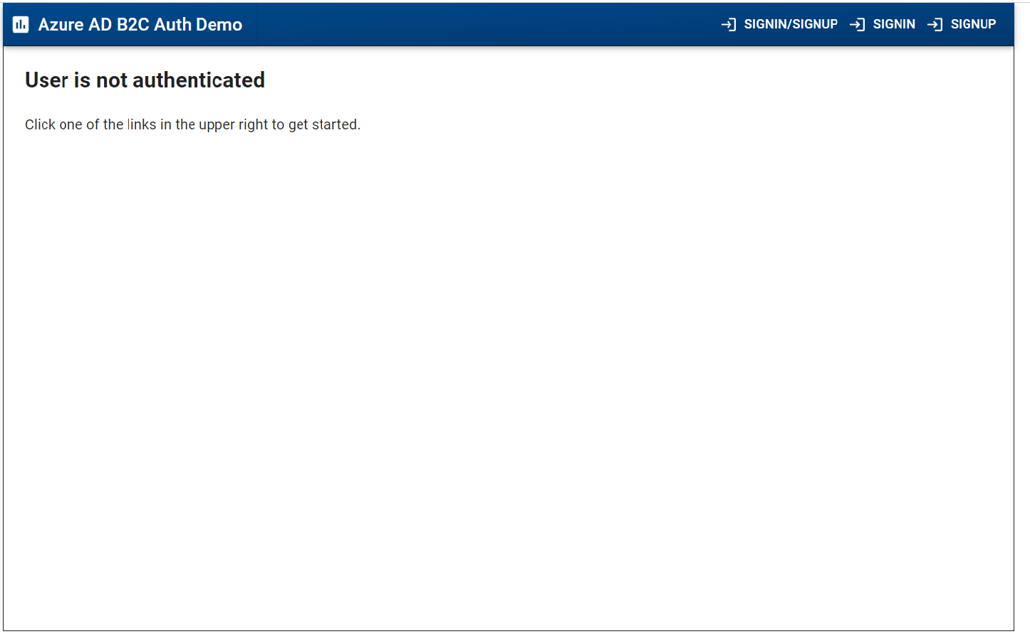
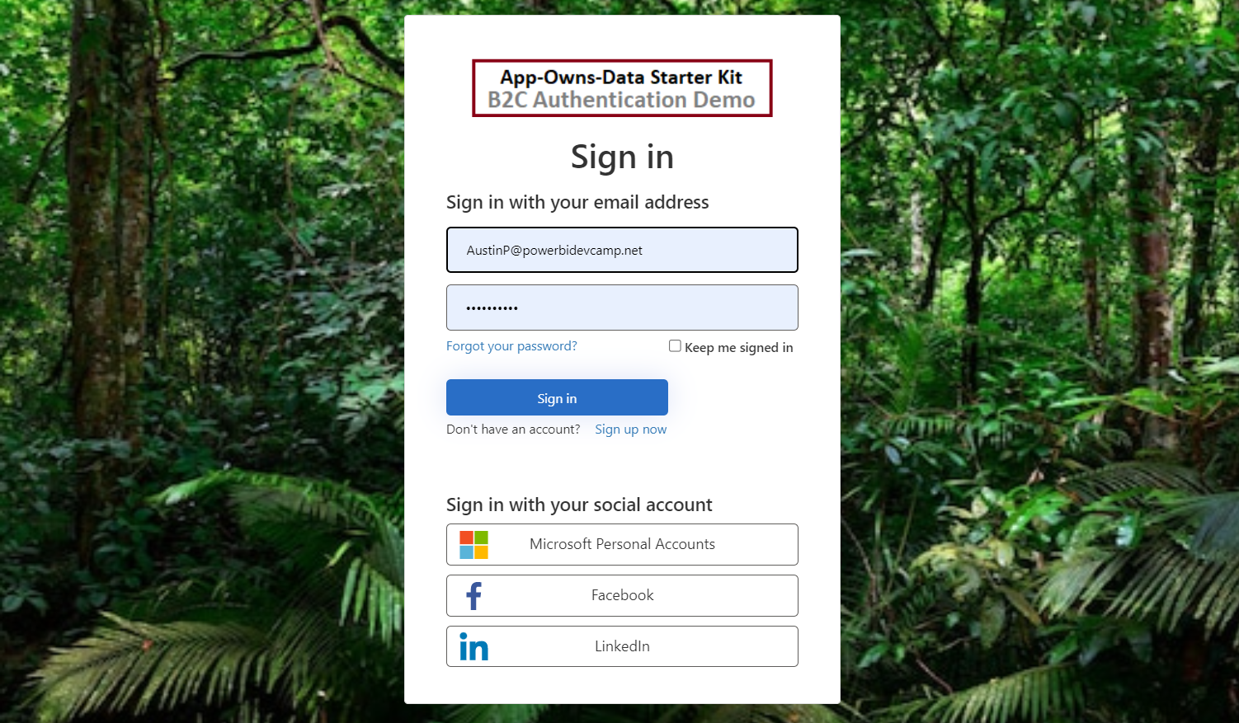
Testing Out the AADB2_MSAL Application

Slide 34
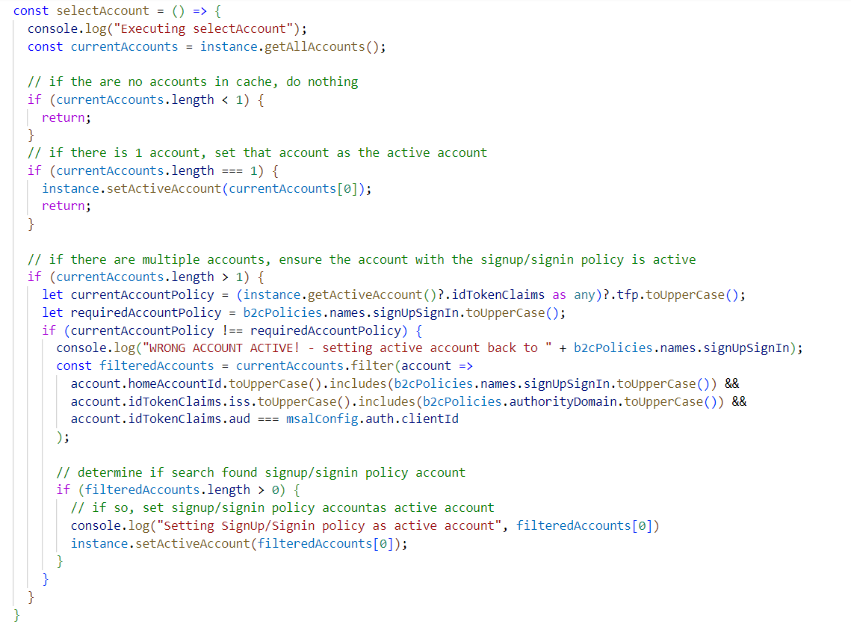
Selecting Signup/Signin Account As the Active Account

Slide 35
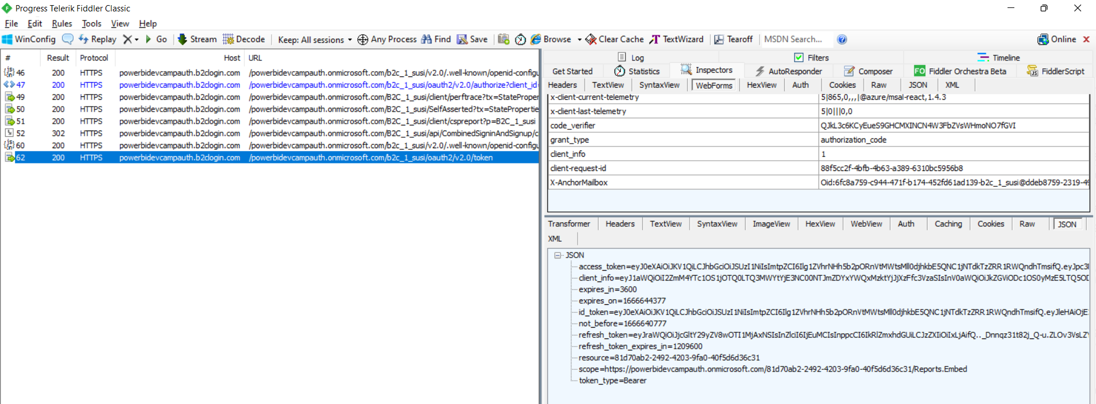
Inspecting the B2C Security Tokens using Fiddler

Slide 36
Agenda
Understanding Azure AD B2C Architecture
Building and Testing User Flows
Acquiring B2C tokens using msal-browser.js
Managing B2C User Accounts using Microsoft Graph API
Developing Custom Policies using Visual Studio Code
Using Azure functions to implement and deploy API Connectors

Slide 37
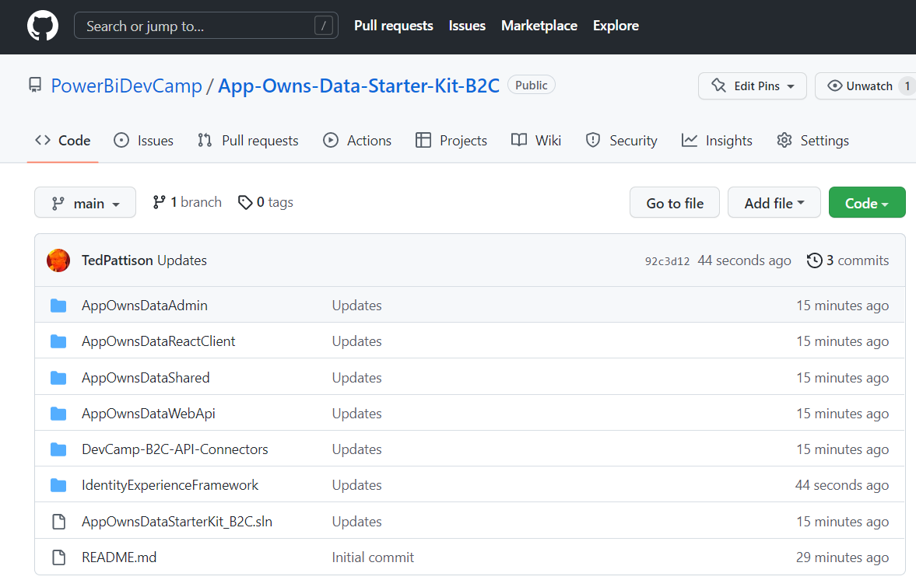
AppOwnsDataStarterKit_B2C a customized Version of the App-Owns-Data Starter Kit
Available for inspection or download in GitHub repository
https://github.com/PowerBiDevCamp/AppOwnsDataStarterKit_B2C
Try out the live demo to experience Azure AD B2C signup and sign in process
https://appownsdatareactclient.azurewebsites.net/

Slide 38
Managing Consumers Accounts with Microsoft Graph API
Custom application can create/update/delete consumer accounts
Microsoft Graph API makes it possible to manage consumer accounts in B2C tenant
AppOwnsDataAdmin
Azure B2C Tenant
Microsoft
Graph API
Local and Federated Accounts

Slide 39

Creating Administrative Application in B2C Tenant
Application requires application permission User.ReadWrite.All

Slide 40

B2CAccountsManager.cs in AppOwnsDataAdmin

Slide 41
Agenda
Understanding Azure AD B2C Architecture
Building and Testing User Flows
Acquiring B2C tokens using msal-browser.js
Managing B2C User Accounts using Microsoft Graph API
Developing Custom Policies using Visual Studio Code
Using Azure functions to implement and deploy API Connectors

Slide 42
Developing Custom Policies
Custom policy are developed in accordance with Identity Experience Framework (IEF)
Policies for authentication and token acquisition defined using customized XML files
Developer must continually edit and upload XM files to test and debug custom policies
Why would you decide to develop custom policies?
They add extra control over what claims get added to token (e.g. verified email address)
They provide ability to integrate Azure AD tenant(s)
They provide ability to integrate other enterprise identity providers such as Salesforce
They provide a wealth of functionality not covered here!
Custom policy development has a steep learning curve
Getting up to speed could take 2-3 months

Slide 43

Getting Started with Custom Policies
Start by going through the steps in this article
https://learn.microsoft.com/en-us/azure/active-directory-b2c/tutorial-create-user-flows?pivots=b2c-custom-policy

Slide 44

B2C Custom Policy Starter Pack
Developers should use XML files from starter pack as project starting point
https://github.com/Azure-Samples/active-directory-b2c-custom-policy-starterpack

Slide 45

Developing Custom Policies with Visual Studio Code
Use the Azure AD B2C extension for Visual Studio Code
Azure AD B2C Policy Explorer
IntelliSense with IEF schema
Automated XML file upload in VS Code for testing
Easy viewing of Azure AD B2C Traces from App Insights

Slide 46

Azure AD B2C Policy Explorer

Slide 47

IntelliSense When Configuring Profile References

Slide 48

Inspecting Azure AD B2C Traces from App Insights

Slide 49

User Journeys and Orchestration Steps
User Journey defines entry point for custom policy (e.g. B2C_1A_customSignupSignIn)
User journey constructed as a sequence of orchestration steps
Orchestration steps reference and execute technical profiles
Orchestration steps can be conditionally skipped based on preconditions

Slide 50

Building Up Claims in the Claims Bag
After orchestration step completes, AAD B2C stores outputted claims in claims bag
Claims added to claims bag can be utilized by later orchestration steps in user journey.

Slide 51
Agenda
Understanding Azure AD B2C Architecture
Building and Testing User Flows
Acquiring B2C tokens using msal-browser.js
Managing B2C User Accounts using Microsoft Graph API
Developing Custom Policies using Visual Studio Code
Using Azure functions to implement and deploy API Connectors

Slide 52

Integrating API Connector with a User Signup Policy
API connector configured to execute after each user signup
User goes through signup process using local account or any federated identity provider
Completion of signup process triggers execution of Azure function
Azure function adds User record to AppOwnsDataDb with default permissions (if any)
Azure function uses email address to send welcome email to user
AppOwnsDataDB
Add user record with default permissions
AppOwnsDataReactClient
user
signup
Azure AD
B2C Tenant
API Connector Callback
Azure Function App
SendGrid
Send welcome email to user

Slide 53

Azure Function Triggered in Response to User Signup

Slide 54
Summary
Understanding Azure AD B2C Architecture
Building and Testing User Flows
Acquiring B2C tokens using msal-browser.js
Managing B2C User Accounts using Microsoft Graph API
Developing Custom Policies using Visual Studio Code
Using Azure functions to implement and deploy API Connectors

Slide 55
Microsoft Power BI
Questions?

